Slide 1
CGB1201 – JAVA PROGRAMMING PROJECT REVIEW-2
Department of Artificial Intelligence
Academic Year: 2024 – 2025 (Odd Semester)
Register Number : 230381171482047
Name : SIVASRI D
Year : II
Semester : III
Section : A
Date : 3/12/2024
Notes:
1

Slide 2
Title of the Project
NEWS PORTAL SYSTEM

Slide 3
Abstract
The News Portal System in Java provides a platform where users can register, log in, and view categorized news articles (e.g., Politics, Sports). It features a simple admin panel for managing content, allowing administrators to add or remove articles. Users can select categories to view relevant news, ensuring a personalized experience. The system emphasizes usability, modularity, and efficient content management, making it a robust and user-friendly solution.

Slide 4
Abstract with CO/PO Mapping
Abstract | CO | POs | PSO
 | C0-4 | PO-1,2,5 | PSO-1,2
Utilizes core Java concepts like OOP, control structures,
and JDBC.
Secure login system with exception handling for reliable data transactions.
Modular packages manage user, admin and article fuctions
Efficiently.

Slide 5
Introduction
The News Portal System is a Java-based application that allows users to register, log in, and view news articles categorized into topics like Politics and Sports. It features an admin panel for adding and removing articles, ensuring up-to-date content. Built using Java's core concepts like OOP, JDBC for database connectivity, and collections for data management, the system offers a user-friendly interface through Swing/JavaFX or CLI. The system provides secure user authentication, efficient article categorization, and dynamic content delivery, making it a robust solution for managing news content.

Slide 6
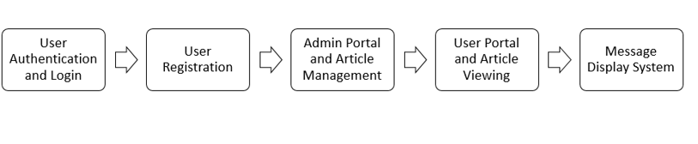
Proposed Architecture

Slide 7
Proposed Architecture - Description
User Authentication and Login:
This is the initial step where users are verified and granted access to the system.
User Registration:
New users can register and create accounts within the system.
Admin Portal and Article Management:
This component allows administrators to manage articles and other content within the system.

Slide 8
Proposed Architecture - Description (Cont..)
User Portal and Article Viewing
The user portal enables users to browse and read articles in responsive interface. It features search and filter functionalities to help users easily find content based on their interests.
Message Display System
The message display system facilitates effective communication and notifications within the platform. It alerts users about updates, new articles, and other important messages.

Slide 9
List of Modules
User Authentication Module
Article Management Module
Article Categorization Module
News Article Viewing Module
Admin Panel Module
Database Management Module
Security Module

Slide 10
Module Description
User Authentication Module Manages user registration, login, password recovery, and session management to ensure secure access.
Article Management Module Allows administrators to create, edit, publish, and delete news articles, including managing multimedia content.
Article Categorization Module Organizes articles into predefined categories (e.g., Sports, Politics) for easier navigation and filtering.

Slide 11
Module Description (Cont..)
News Article Viewing Module Provides users with the ability to browse, search, and read articles, often with options for sorting and filtering.
Admin Panel Module A centralized interface for administrators to oversee user activities, manage content, and access analytics.
Database Management Module Handles data storage, retrieval, and management for users and articles, ensuring data integrity and performance.
Security Module Implements measures to protect user data and prevent unauthorized access, including encryption and access controls.

Slide 12
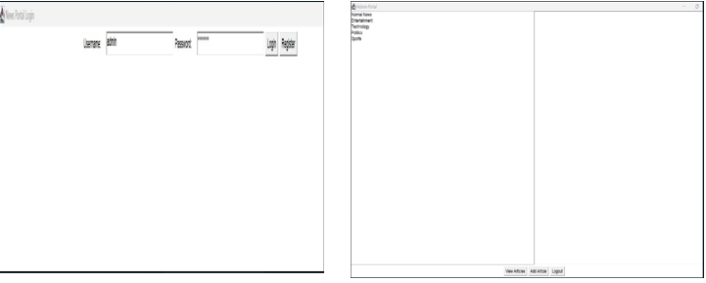
Results and Discussion (Cont..)

Slide 13
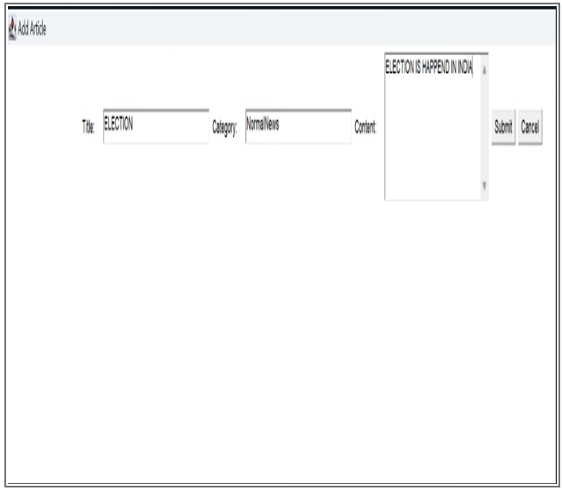
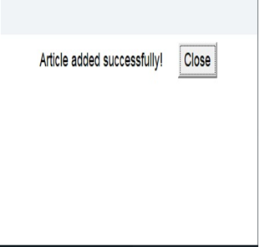
Results and Discussion

Slide 14
Conclusion
The Java-based news portal system effectively demonstrates essential functionalities for user authentication and article management, providing a solid foundation for a basic news platform. While it allows users to register, log in, and manage articles, the current implementation has limitations in terms of data persistence, security, and user experience. Future enhancements, such as integrating a database, improving password security, and adding features like search functionality and a commenting system, will significantly bolster the system's robustness and usability. Overall, this project serves as a functional prototype with considerable potential for growth and refinement, paving the way for a more comprehensive and user-friendly news platform.

Slide 15
Thank You
Any queries???

